Slide 1
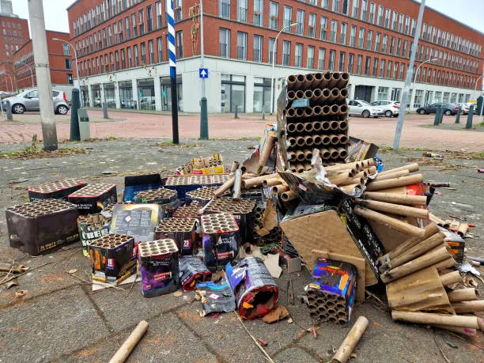
Analysis for: garbage1.webp
User Description: A large pile of trash bags and loose rubbish is overflowing onto the sidewalk next to a building. Spam Check: Not Spam (Score: 0.50) ------------------------------------ AI Model Prediction: garbage_dump Confidence: 78.96% AI Generated Caption: a pile of discarded items on the street Detected Objects: car (0.75), car (0.61), car (0.44), car (0.43)

Slide 2
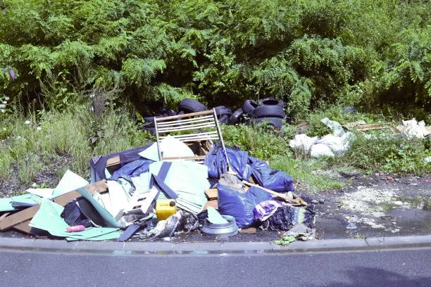
Analysis for: garbage10.webp
User Description: A significant amount of garbage has been dumped on a grassy area next to a road. Spam Check: Not Spam (Score: 0.75) ------------------------------------ AI Model Prediction: garbage_dump Confidence: 61.39% AI Generated Caption: a pile of trash on the side of a road Detected Objects: boat (0.42)

Slide 3
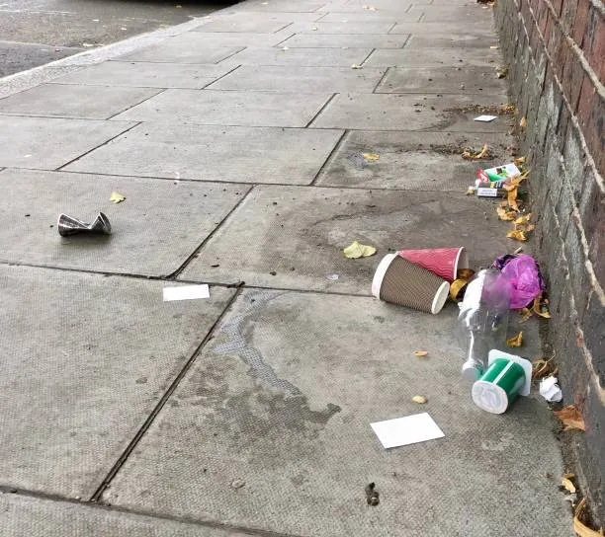
Analysis for: garbage2.webp
User Description: The public trash can is full and garbage is spilling out onto the surrounding pavement. Spam Check: Not Spam (Score: 0.60) ------------------------------------ AI Model Prediction: garbage_dump Confidence: 57.04% AI Generated Caption: a pile of trash on the sidewalk next to a brick wall Detected Objects: bird (0.25)

Slide 4
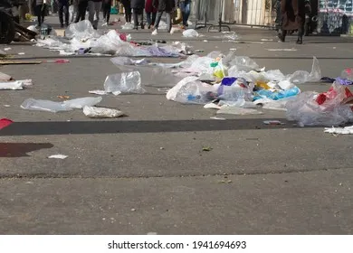
Analysis for: garbage3.webp
User Description: Uncollected trash bags are lined up along the side of a street. Spam Check: Not Spam (Score: 0.51) ------------------------------------ AI Model Prediction: garbage_dump Confidence: 99.77% AI Generated Caption: a group of people walking down a street with trash Detected Objects: person (0.59), person (0.50), person (0.42), person (0.40), person (0.32), bird (0.29), person (0.28), person (0.28)

Slide 5
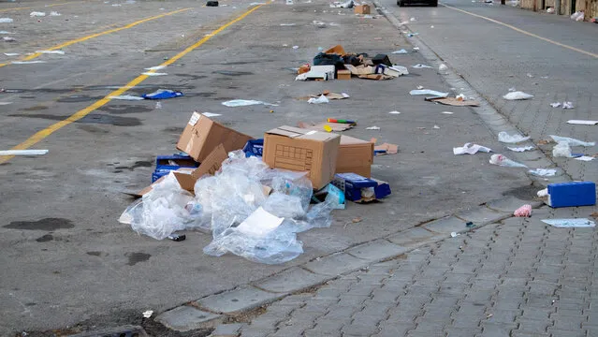
Analysis for: garbage4.webp
User Description: Construction debris and refuse have been left on the roadside. Spam Check: Not Spam (Score: 0.49) ------------------------------------ AI Model Prediction: broken_streetlight Confidence: 62.85% AI Generated Caption: a street with trash and trash on the side Detected Objects: None

Slide 6
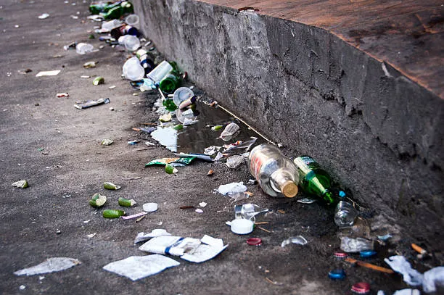
Analysis for: garbage5.webp
User Description: A large collection of garbage bags is piled up against a concrete wall. Spam Check: Not Spam (Score: 0.65) ------------------------------------ AI Model Prediction: garbage_dump Confidence: 99.94% AI Generated Caption: a wall with a bunch of trash on it Detected Objects: None

Slide 7
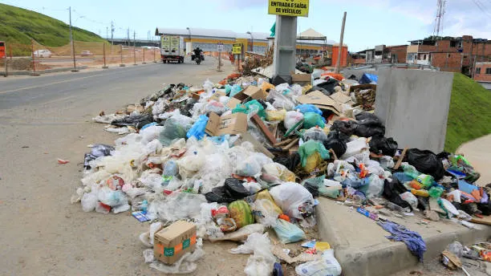
Analysis for: garbage6.webp
User Description: An overflowing heap of trash is dumped on the curb of a street. Spam Check: Not Spam (Score: 0.77) ------------------------------------ AI Model Prediction: garbage_dump Confidence: 99.92% AI Generated Caption: a pile of garbage on the side of a road Detected Objects: None

Slide 8
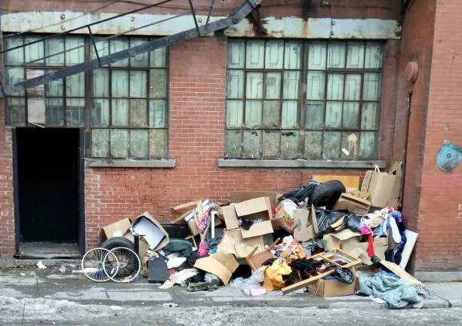
Analysis for: garbage7.webp
User Description: Waste and litter are scattered across the ground in a public space. Spam Check: Not Spam (Score: 0.64) ------------------------------------ AI Model Prediction: waterlogging Confidence: 99.37% AI Generated Caption: a pile of trash outside a building Detected Objects: clock (0.59)

Slide 9
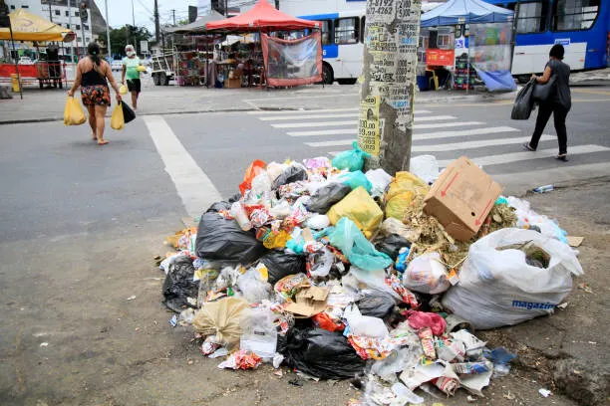
Analysis for: garbage8.webp
User Description: Numerous bags of trash are piled up on the side of a street waiting for collection. Spam Check: Not Spam (Score: 0.70) ------------------------------------ AI Model Prediction: garbage_dump Confidence: 99.66% AI Generated Caption: a pile of trash on the side of a street Detected Objects: person (0.85), person (0.78), person (0.64), handbag (0.62), handbag (0.46), car (0.43), bus (0.42), handbag (0.42), umbrella (0.42), bus (0.31)

Slide 10
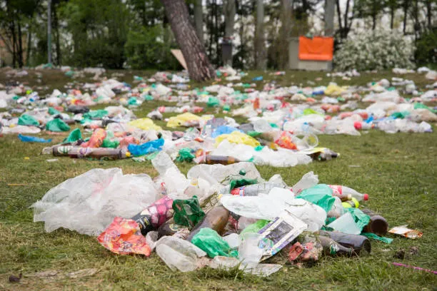
Analysis for: garbage9.webp
User Description: A large mound of plastic bottles and other refuse is covering a patch of grass. Spam Check: Not Spam (Score: 0.75) ------------------------------------ AI Model Prediction: garbage_dump Confidence: 99.94% AI Generated Caption: a pile of plastic bottles and other trash on the grass Detected Objects: None

Slide 11
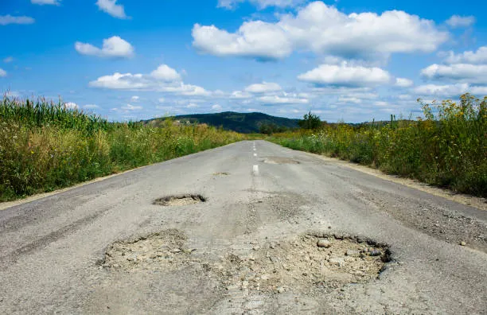
Analysis for: pothole1.webp
User Description: A deep, rectangular pothole has formed in the asphalt road surface. Spam Check: Not Spam (Score: 0.57) ------------------------------------ AI Model Prediction: pothole Confidence: 78.92% AI Generated Caption: a road with a small patch of dirt on the side Detected Objects: None

Slide 12
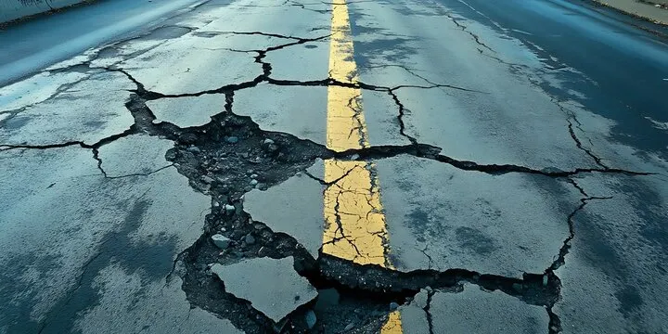
Analysis for: pothole10.webp
User Description: The road surface is severely cracked and broken, creating a driving hazard. Spam Check: Not Spam (Score: 0.64) ------------------------------------ AI Model Prediction: pothole Confidence: 98.00% AI Generated Caption: a road with a cracked road and a yellow line Detected Objects: None

Slide 13
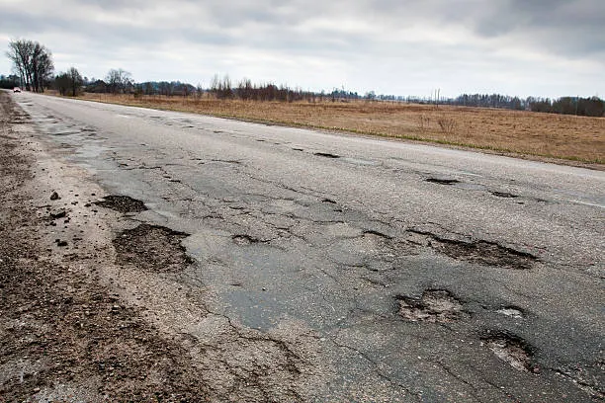
Analysis for: pothole2.webp
User Description: There is a significant pothole in the middle of the paved road. Spam Check: Not Spam (Score: 0.90) ------------------------------------ AI Model Prediction: pothole Confidence: 98.46% AI Generated Caption: a road with a pothole in the middle of it Detected Objects: None

Slide 14
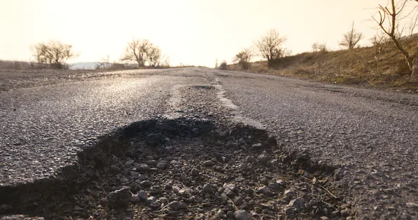
Analysis for: pothole3.webp
User Description: The edge of the road has a large, deep pothole. Spam Check: Not Spam (Score: 0.80) ------------------------------------ AI Model Prediction: pothole Confidence: 99.41% AI Generated Caption: a pothole on the side of a road Detected Objects: None

Slide 15
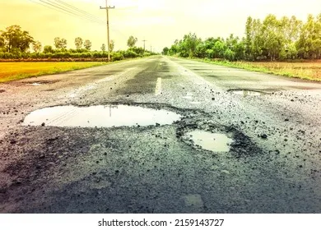
Analysis for: pothole4.webp
User Description: Several large puddles have formed in potholes on a damaged road. Spam Check: Not Spam (Score: 0.62) ------------------------------------ AI Model Prediction: pothole Confidence: 97.35% AI Generated Caption: asphalt road with puddles and power lines Detected Objects: None

Slide 16
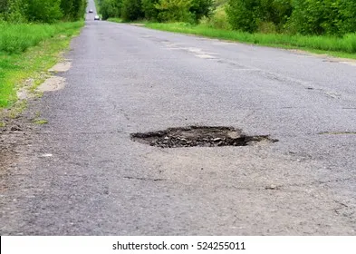
Analysis for: pothole5.webp
User Description: A distinct hole is present in the center of the asphalt road. Spam Check: Not Spam (Score: 0.77) ------------------------------------ AI Model Prediction: pothole Confidence: 96.92% AI Generated Caption: a road with a hole in the middle Detected Objects: None

Slide 17
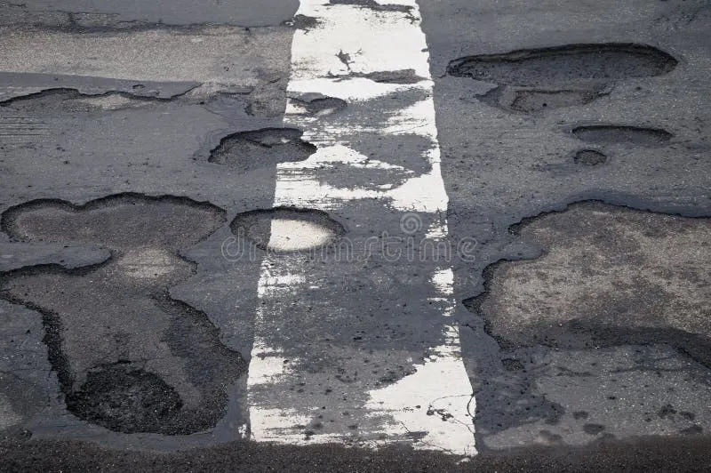
Analysis for: pothole6.webp
User Description: A section of the road is damaged with multiple connected potholes. Spam Check: Potential Spam (Score: 0.27) ------------------------------------ AI Model Prediction: pothole Confidence: 99.91% AI Generated Caption: a white line on the road with a white line in the middle of it royalty image Detected Objects: None

Slide 18
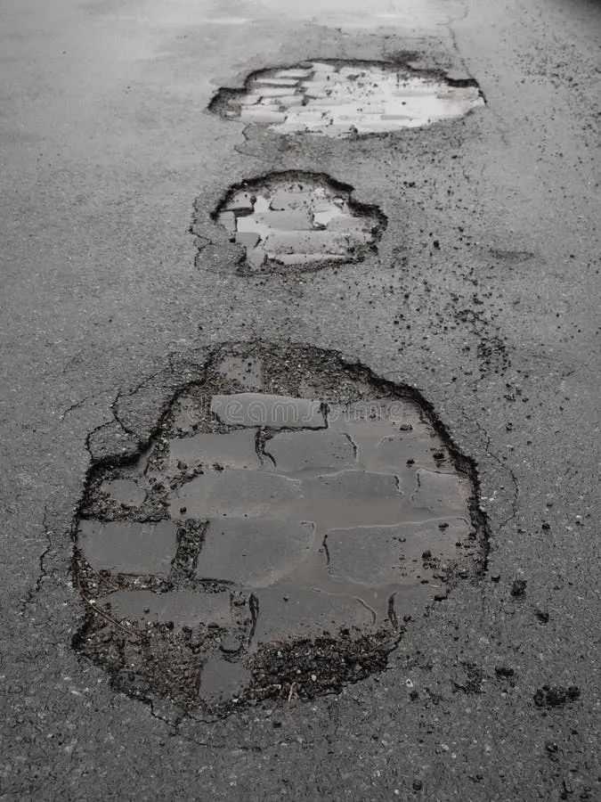
Analysis for: pothole7.webp
User Description: A close-up view of a deep pothole in the road's surface. Spam Check: Not Spam (Score: 0.81) ------------------------------------ AI Model Prediction: pothole Confidence: 99.94% AI Generated Caption: a pothole in the road with a pothole on it Detected Objects: None

Slide 19
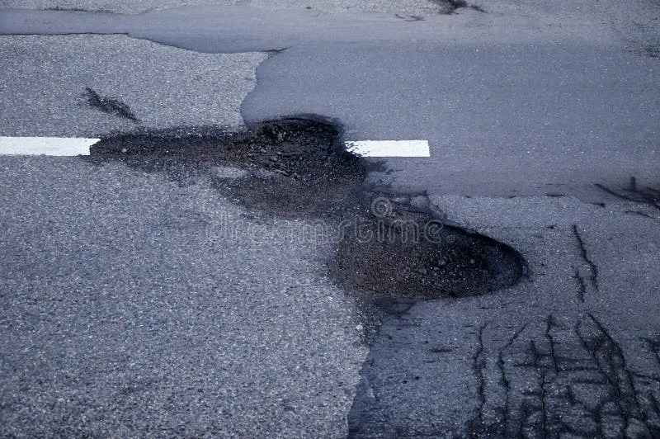
Analysis for: pothole8.webp
User Description: A severe pothole in the road has been marked with a white cross. Spam Check: Not Spam (Score: 0.93) ------------------------------------ AI Model Prediction: pothole Confidence: 99.85% AI Generated Caption: a pothole in the road with a white cross on it Detected Objects: None

Slide 20
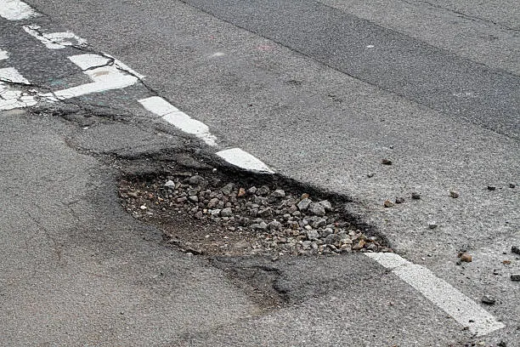
Analysis for: pothole9.webp
User Description: A large, water-filled pothole is visible on the street. Spam Check: Not Spam (Score: 0.79) ------------------------------------ AI Model Prediction: pothole Confidence: 99.90% AI Generated Caption: a pothole in the road Detected Objects: None

Slide 21
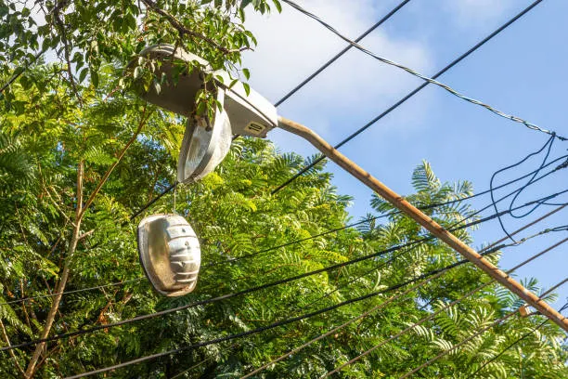
Analysis for: stbroken1.webp
User Description: A pair of shoes is hanging from a wire on a utility pole. Spam Check: Not Spam (Score: 0.81) ------------------------------------ AI Model Prediction: broken_streetlight Confidence: 99.94% AI Generated Caption: a pair of shoes hanging from a telephone pole Detected Objects: None

Slide 22
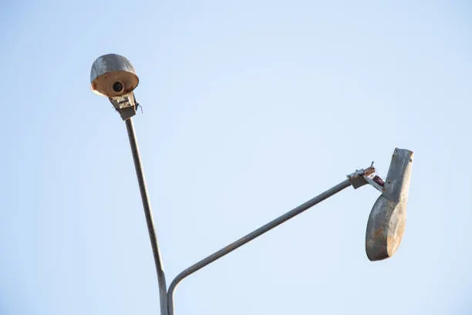
Analysis for: stbroken2.webp
User Description: A street light is shown with a bird perched on top of it. Spam Check: Not Spam (Score: 0.87) ------------------------------------ AI Model Prediction: broken_streetlight Confidence: 100.00% AI Generated Caption: a street light with a bird on it ' s head Detected Objects: airplane (0.52)

Slide 23
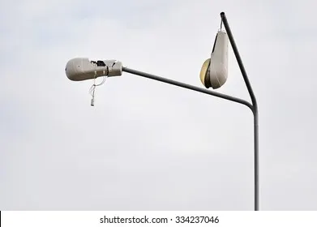
Analysis for: stbroken3.webp
User Description: A standard street light is pictured against a cloudy sky. Spam Check: Not Spam (Score: 0.91) ------------------------------------ AI Model Prediction: broken_streetlight Confidence: 100.00% AI Generated Caption: a street light with a cloudy sky in the background Detected Objects: None

Slide 24

Analysis for: stbroken4.webp
User Description: A bird is sitting on top of a street lamp. Spam Check: Not Spam (Score: 0.83) ------------------------------------ AI Model Prediction: broken_streetlight Confidence: 100.00% AI Generated Caption: a bird is perched on a street light Detected Objects: None

Slide 25
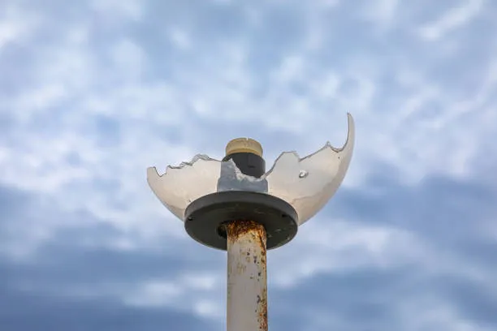
Analysis for: stbroken5.webp
User Description: A street light pole is shown against a clear blue sky. Spam Check: Not Spam (Score: 0.85) ------------------------------------ AI Model Prediction: broken_streetlight Confidence: 100.00% AI Generated Caption: a white light pole with a blue sky in the background Detected Objects: kite (0.50)

Slide 26
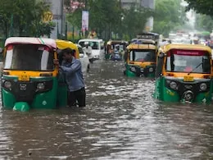
Analysis for: wl1.webp
User Description: A city street is completely flooded with murky water. Spam Check: Not Spam (Score: 0.61) ------------------------------------ AI Model Prediction: waterlogging Confidence: 99.99% AI Generated Caption: a flooded street in mumbai Detected Objects: person (0.80), boat (0.61), truck (0.55), suitcase (0.44), boat (0.44), suitcase (0.43), suitcase (0.39), suitcase (0.37), car (0.30), car (0.28), truck (0.26)

Slide 27
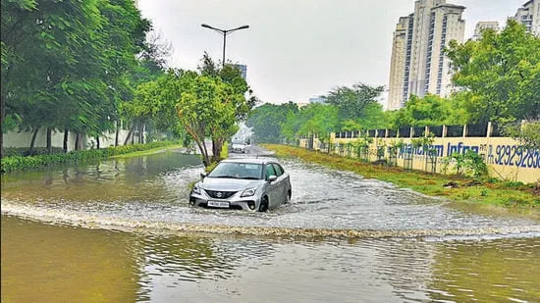
Analysis for: wl10.webp
User Description: A car is driving through a heavily flooded street, creating a large wake. Spam Check: Not Spam (Score: 0.82) ------------------------------------ AI Model Prediction: waterlogging Confidence: 99.98% AI Generated Caption: a car is driving through a flooded street Detected Objects: car (0.87)

Slide 28
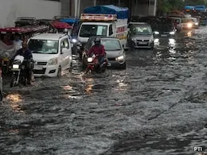
Analysis for: wl2.webp
User Description: Multiple cars are stuck in deep floodwater on a city street. Spam Check: Not Spam (Score: 0.73) ------------------------------------ AI Model Prediction: waterlogging Confidence: 53.56% AI Generated Caption: cars are stuck in flood waters in the city of ahmedabad Detected Objects: car (0.70), car (0.67), person (0.67), person (0.53), truck (0.51), truck (0.51), car (0.47), motorcycle (0.42), car (0.36), car (0.29), car (0.28)

Slide 29
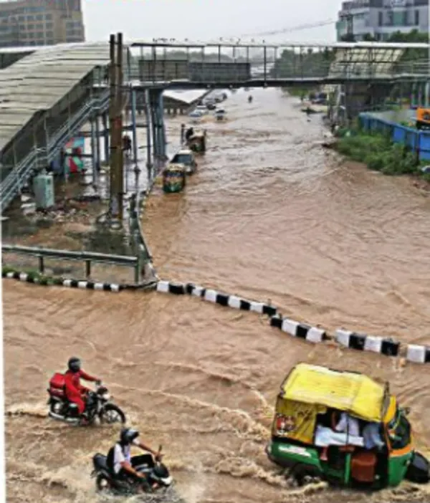
Analysis for: wl3.webp
User Description: A street is submerged in water following heavy rainfall. Spam Check: Not Spam (Score: 0.56) ------------------------------------ AI Model Prediction: waterlogging Confidence: 99.89% AI Generated Caption: a flooded street in the city of ahmedabad Detected Objects: person (0.74), motorcycle (0.55), person (0.49), train (0.45), motorcycle (0.39), truck (0.31)

Slide 30
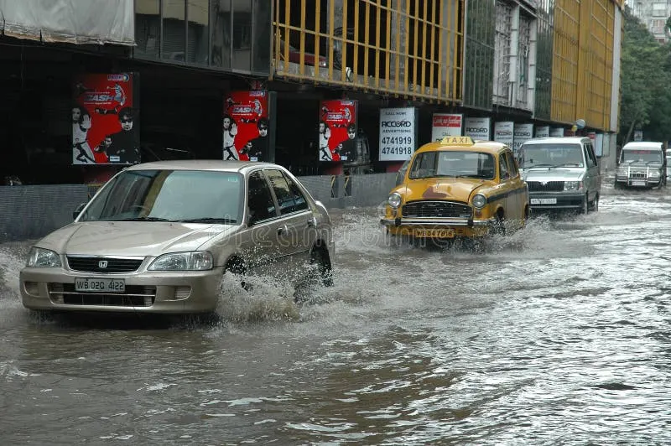
Analysis for: wl4.webp
User Description: Vehicles are navigating through a street covered in floodwater. Spam Check: Not Spam (Score: 0.66) ------------------------------------ AI Model Prediction: waterlogging Confidence: 99.84% AI Generated Caption: cars driving through flooded street in mumbai Detected Objects: car (0.93), car (0.74), car (0.69), truck (0.61), truck (0.47), car (0.28), person (0.27)

Slide 31
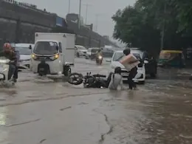
Analysis for: wl5.webp
User Description: Several people are wading through a flooded street. Spam Check: Not Spam (Score: 0.77) ------------------------------------ AI Model Prediction: waterlogging Confidence: 99.99% AI Generated Caption: a group of people standing in the middle of a flooded street Detected Objects: truck (0.88), person (0.68), car (0.56), person (0.54), car (0.42), person (0.41), motorcycle (0.25)

Slide 32
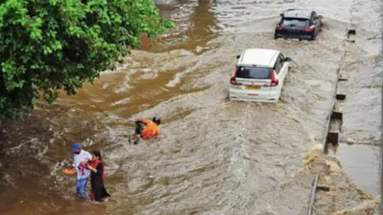
Analysis for: wl6.webp
User Description: A car is almost completely submerged in a severely flooded area. Spam Check: Not Spam (Score: 0.81) ------------------------------------ AI Model Prediction: waterlogging Confidence: 100.00% AI Generated Caption: a car is submerged in a flooded street Detected Objects: person (0.82), car (0.77), car (0.74), person (0.71), person (0.33), person (0.25)

Slide 33
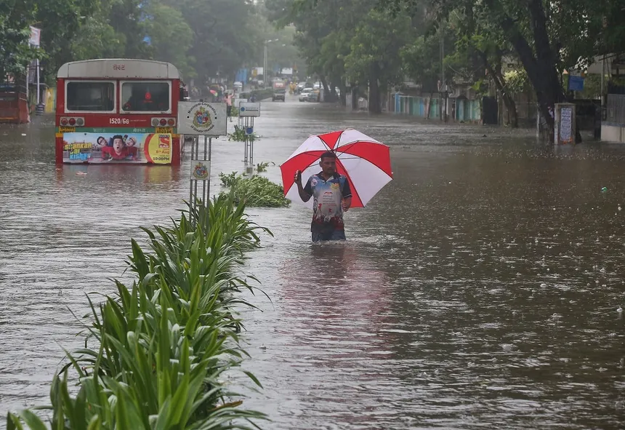
Analysis for: wl7.webp
User Description: A person is walking through a flooded street with water up to their knees. Spam Check: Not Spam (Score: 0.62) ------------------------------------ AI Model Prediction: waterlogging Confidence: 99.99% AI Generated Caption: a woman walks through a flooded street in the city of yangyangan, china Detected Objects: umbrella (0.88), bus (0.87), person (0.77)

Slide 34
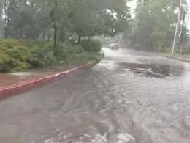
Analysis for: wl8.webp
User Description: A vehicle is driving down a waterlogged road. Spam Check: Not Spam (Score: 0.73) ------------------------------------ AI Model Prediction: waterlogging Confidence: 91.00% AI Generated Caption: a car driving down a flooded street Detected Objects: None

Slide 35
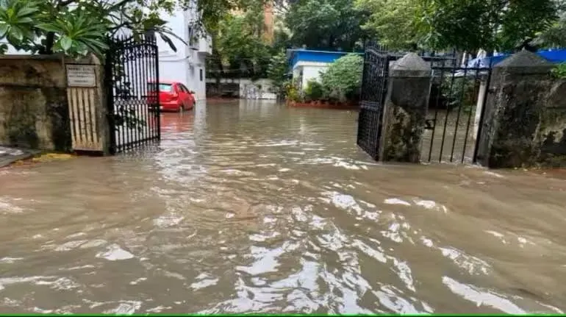
Analysis for: wl9.webp
User Description: A city street is inundated with floodwater, with buildings in the background. Spam Check: Not Spam (Score: 0.60) ------------------------------------ AI Model Prediction: waterlogging Confidence: 100.00% AI Generated Caption: flood in the streets of mumbai Detected Objects: car (0.78)

